Slide 1

V NFT
Decentralized AMM with NFT LP Positions
Team: y98_7c71

Slide 2
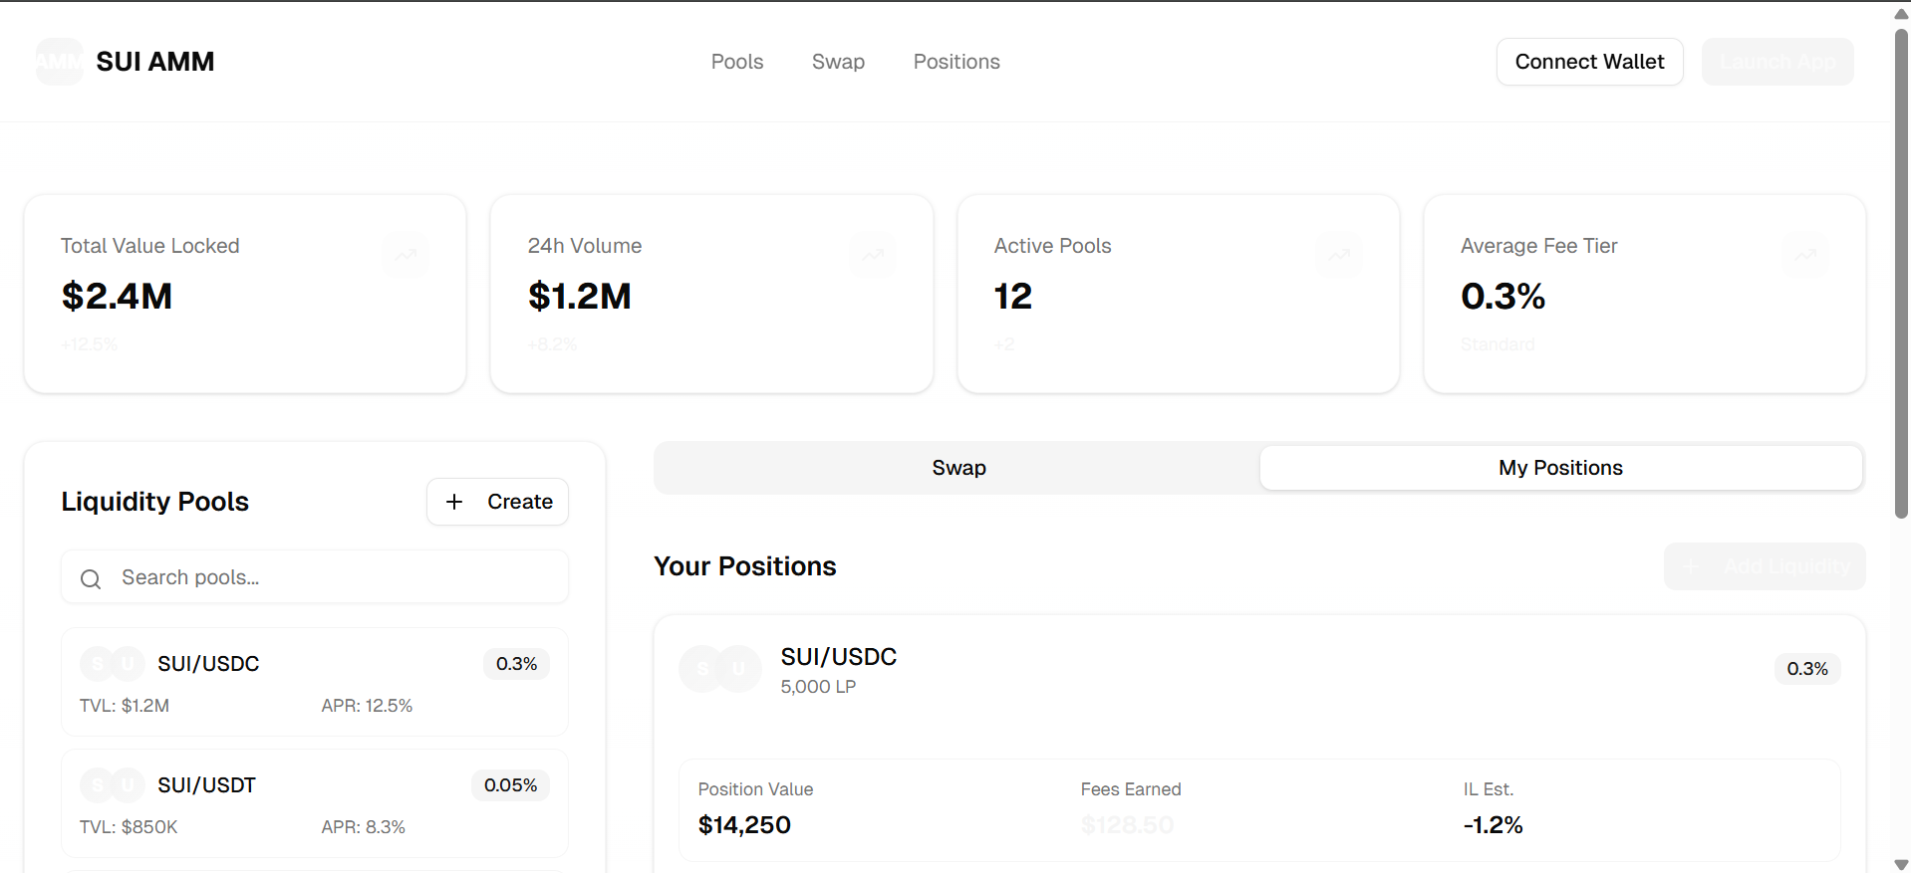
Dashboard
Team: y98_7c71

Slide 3
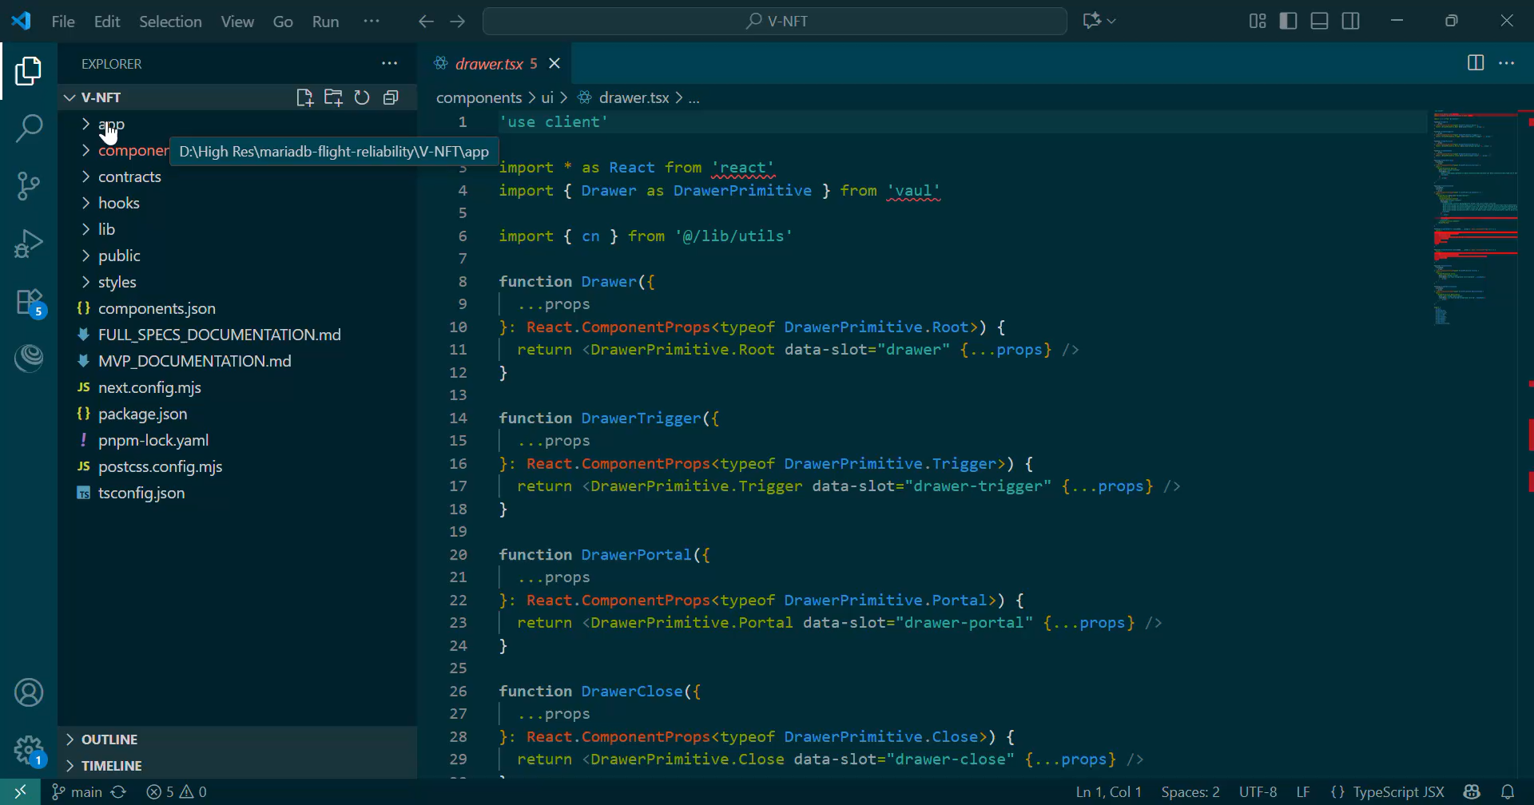
Code
Team: y98_7c71

Slide 4
Thank You
Team: y98_7c71

